Slide 1
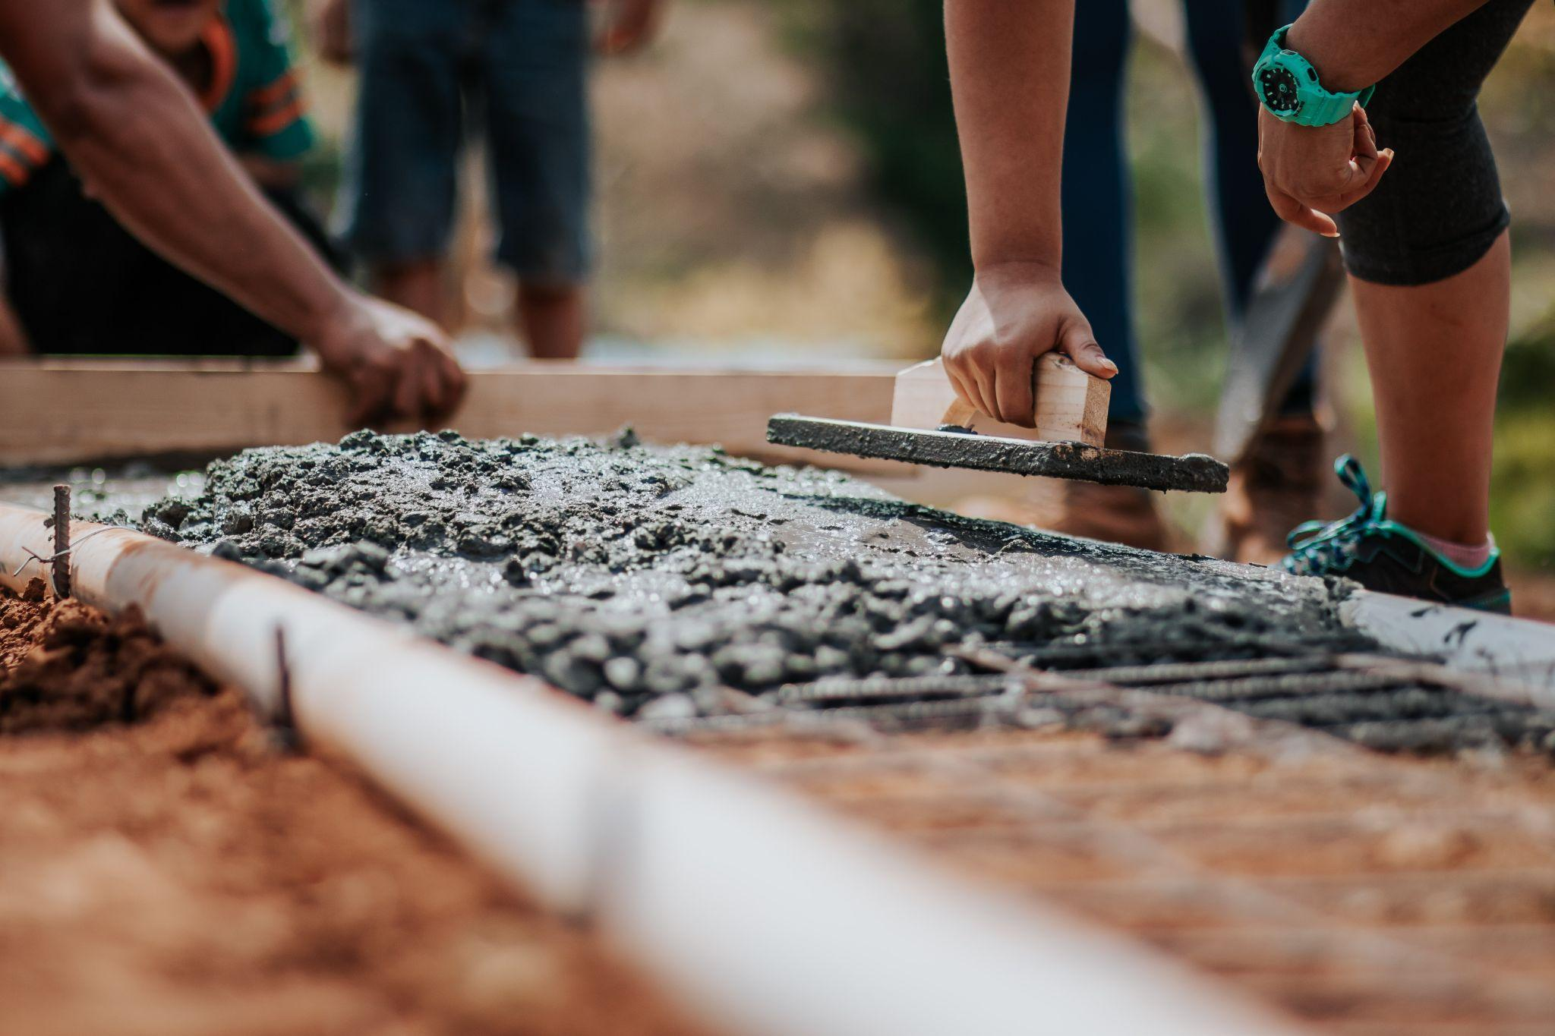
108th World Day of Migrants and Refugees 2022
Building the Future with Migrants and Refugees
Notes:
Leader: Today we come together for the World Day of Refugees and Migrants. We remember the difficult journeys that people have to make, and how hard it can be to start again in a new country. We also remember the gifts of all the different cultures and how they have enriched our lives in Australia. Pope Francis calls this “beautiful diversity”. In his letter for the World Day, he asks us to build the future together with migrants and refugees, a place of inclusion and harmony, so it ends up looking just like the Kingdom of God.
Let us begin with an Acknowledgement of Country.

Slide 2
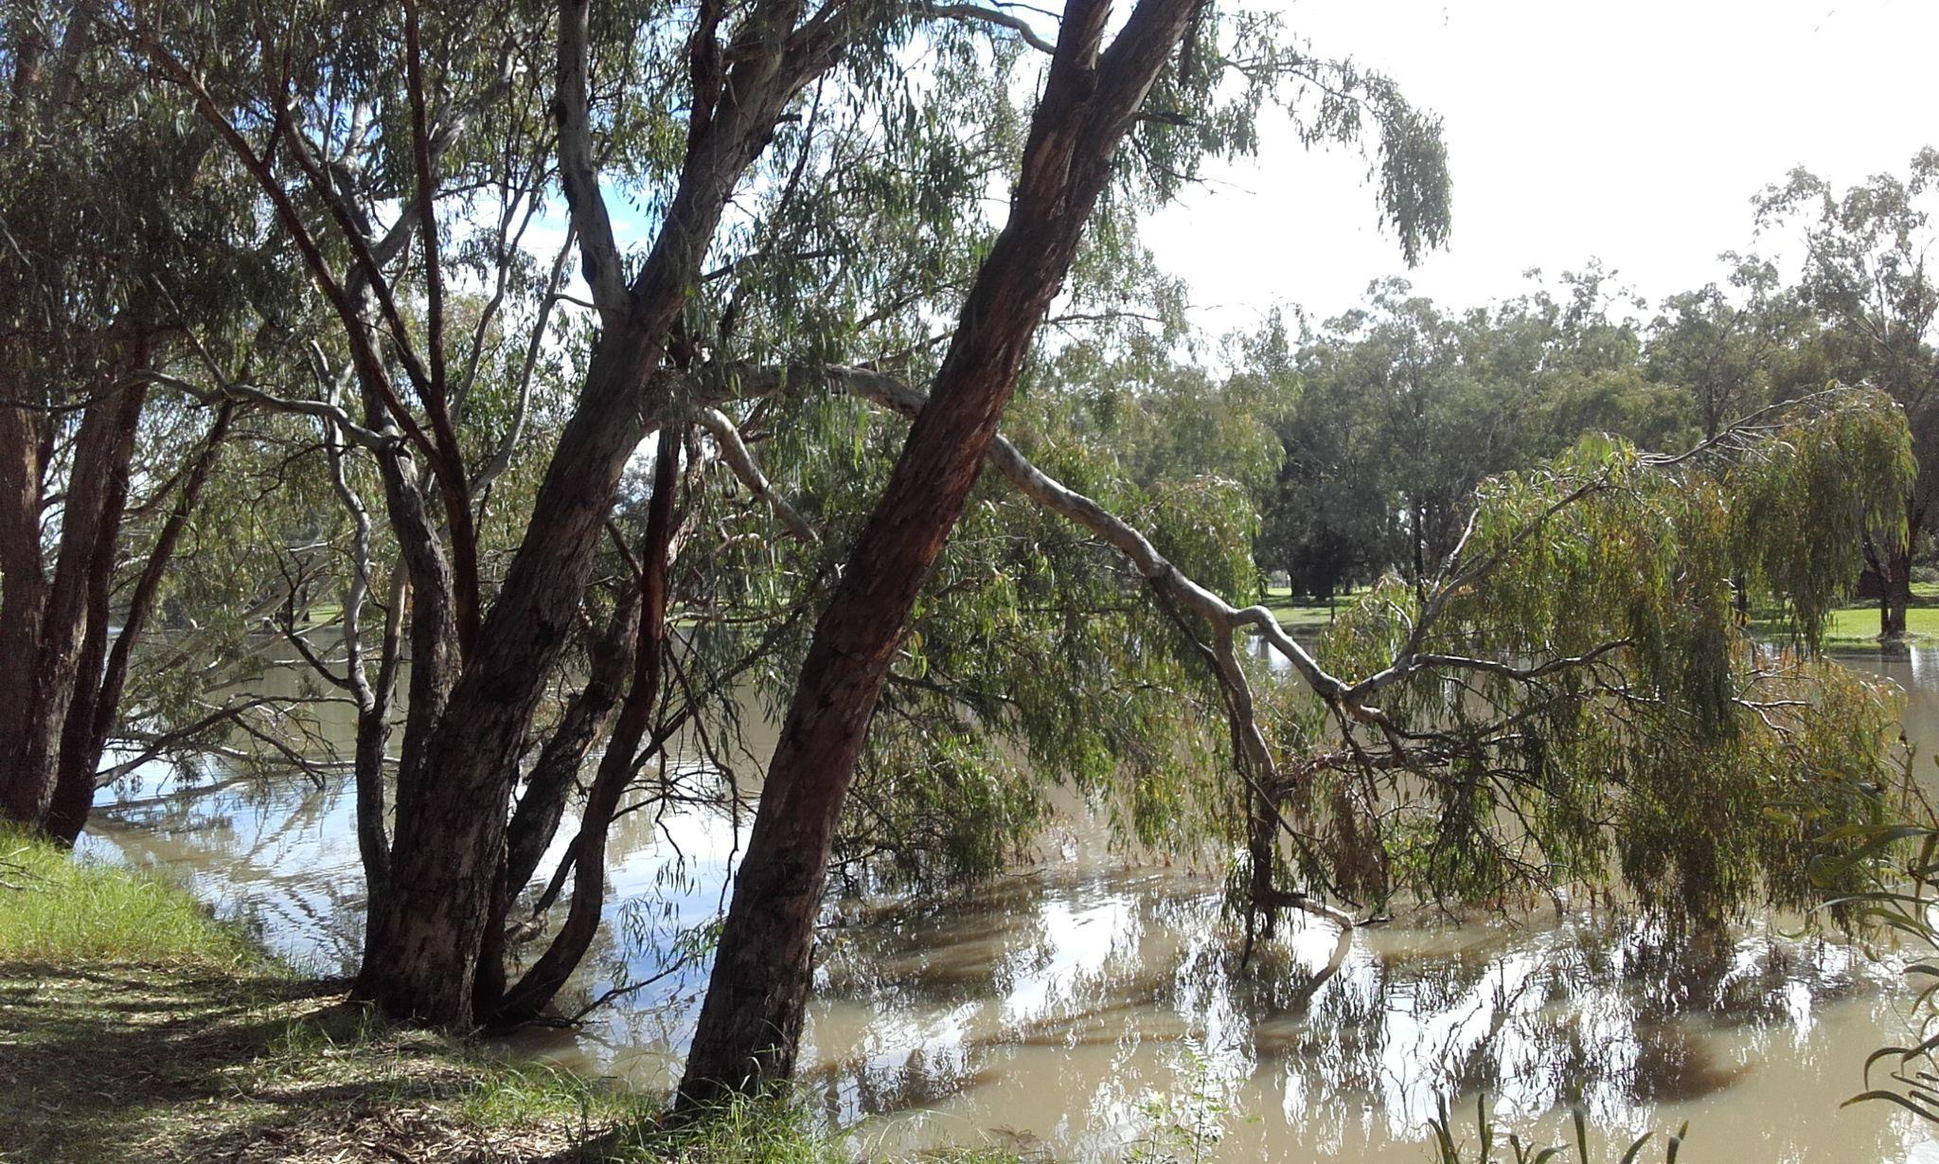
Acknowledgement
of Country
Notes:
Reader 1: We acknowledge the people who have cared for this sacred land for thousands of generations. We acknowledge the wisdom and leadership of the elders: past, present and emerging. We thank them for the foundations they have built and we pray that we can join together in a spirit of justice and reconciliation for God’s land into the future.

Slide 3
Sign of the Cross and
Opening Prayer
Response: Amen.
Notes:
Leader: Let us begin:
+ In the name of the Father, and of the Son, and of the Holy Spirit.
All: Amen.
Leader: Let us pray in the words of Pope Francis … (pause) …
Lord, make us bearers of hope,
so that where there is darkness,
your light may shine,
and where there is discouragement,
confidence in the future may be reborn.
Lord, make us instruments of your justice,
so that where there is exclusion, solidarity may flourish,
and where there is greed, a spirit of sharing may grow.
Through Christ our Lord,
All: Amen.

Slide 4
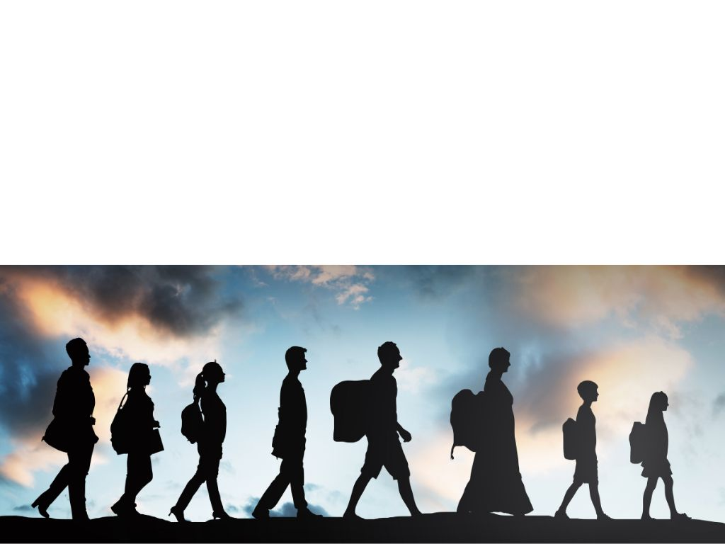
Reading: Hebrews 11:8-10
Notes:
Leader: Let us now listen to the story of Abraham, who migrated to had to go to another
country and learn to trust in God.
Reader 2: A reading from the letter to the Hebrews [11:8-10, Good News Bible].
It was faith that made Abraham obey when God called him to go out to a country which God had promised to give him. He left his own country without knowing where he was going. By faith he lived as a foreigner in the country that God had promised him. He lived in tents, as did Isaac and Jacob, who received the same promise from God. For Abraham was waiting for the city which God has designed and built, the city with permanent foundations.
Leader: Let us now watch a video that explains a little bit more about life as a foreigner like Abraham.

Slide 5
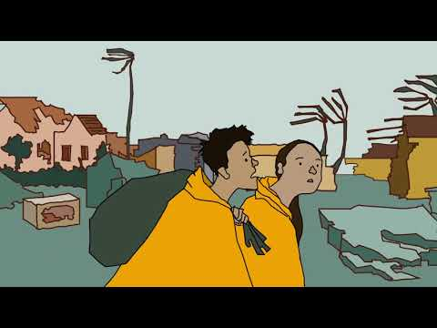

Slide 6
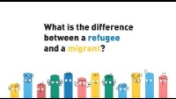

Slide 7
We Respond in Prayer
Response: Lord, hear our prayer.
…through Christ our Lord: Amen.
Notes:
Leader: So let us pray to our God, who calls us to be builders and bearers of hope.
Reader 3: For Pope Francis and the whole Church.
May we build the Kingdom of God alongside migrants, refugees, and all who are on the margins of our world. Lord, hear us.
All: Lord, hear our prayer.
Reader 4: For our government and civil leaders.
May they give care and compassion for those who seek a welcome in our land,
release those who are unjustly imprisoned and build an inclusive and equal society. Lord, hear us.
All: Lord, hear our prayer.
Reader 5: For those who have migrated to Australia, and their families.
May they not be despised or ignored, but appreciated for their gifts and invited to share their lives and experiences. Lord, hear us.
All: Lord, hear our prayer.
Reader 6: For those who have come to Australia seeking asylum or safety.
May they be treated with love, supported to heal from their trauma, and embraced in their wonderful diversity. Lord, hear us.
All: Lord, hear our prayer.
Reader 7: For our school community.
May we be instruments of God’s justice as we build the future of hope together. Lord, hear us.
All: Lord, hear our prayer.
Leader: Good and loving God, your son Jesus taught us that no one should be excluded. Inspire us to welcome the stranger and work together for the city that you have designed. We ask this through Christ our Lord.
All: Amen.

Slide 8
All: Lord, make us builders of your Kingdom,
together with migrants and refugees
and with all who live on the edges.
Lord, let us learn how beautiful it is
to live together as brothers and sisters.
Amen.
Notes:
Leader: So let us conclude with the final part of the prayer of Pope Francis:
All: Lord, make us builders of your Kingdom,
together with migrants and refugees
and with all who dwell on the margins.
Lord, let us learn how beautiful it is
to live together as brothers and sisters. Amen.
Amen.

Slide 9
Blessing and Dismissal
Response: Amen.
…to build the Kingdom of God: Thanks be to God!
Notes:
Leader: May the God of welcome bless and protect us, + Father, Son, and Holy Spirit.
All: Amen.
Leader: And let us go in peace to build the Kingdom of God!
All: Thanks be to God!

Slide 11
108th World Day of Migrants and Refugees 2022
Produced by the Australian Catholic Migrant and Refugee Office
Photos from pexels.com and canva.com, Videos from youtube.com
Building the Future with Migrants and Refugees

