Slide 1


Slide 2


Slide 3
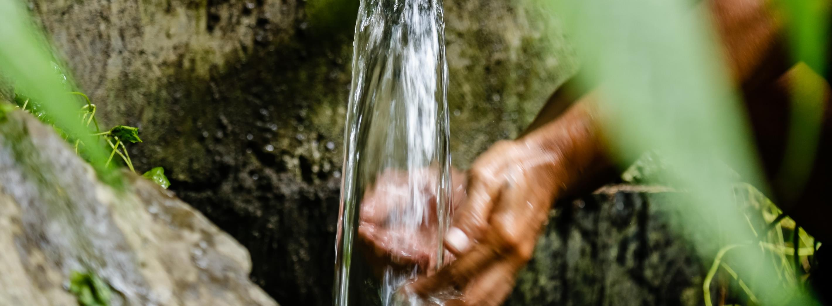
God of Living Water, lead us into your life of love and justice for all. Lord, hear us. ​​ Lord, hear our prayer.​​
Photo: Neil Nuia
Notes:
Image caption: Caritas Australia Solomon Islands (CASI) staff work to repair a gravity fed water system that was damaged during a landslide next to the rural training centre near the capital Honiara, Solomon Islands, August 2021. Photo: Neil Nuia

Slide 4
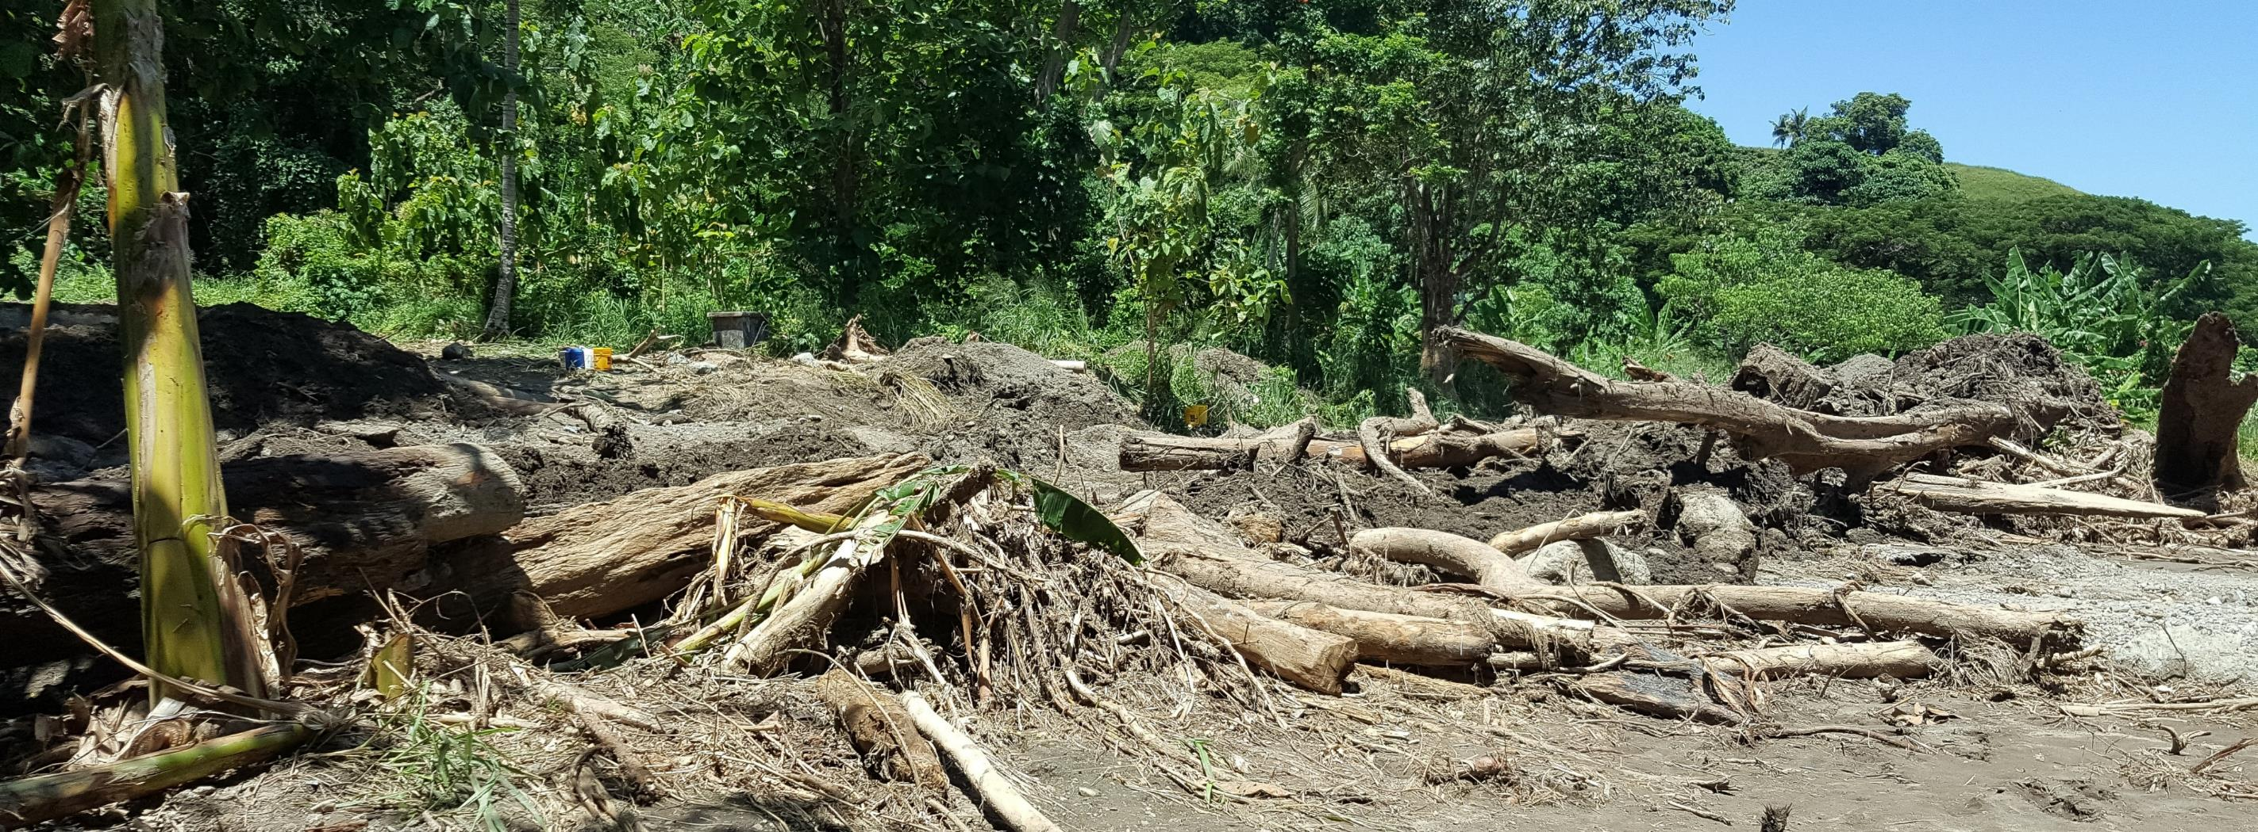
Help us listen to the cry of the earth. Show us how we are one part of your big, beautiful creation. Inspire us to act with care for the environment around us. Lord, hear us. ​​ Lord, hear our prayer.​​
Photo: Neil Nuia
Notes:
Image caption: A general view of the area a landslide occurred next to the Rural Training Centre near the capital Honiara, Solomon Islands, August 2021. Photo: Neil Nuia

Slide 5
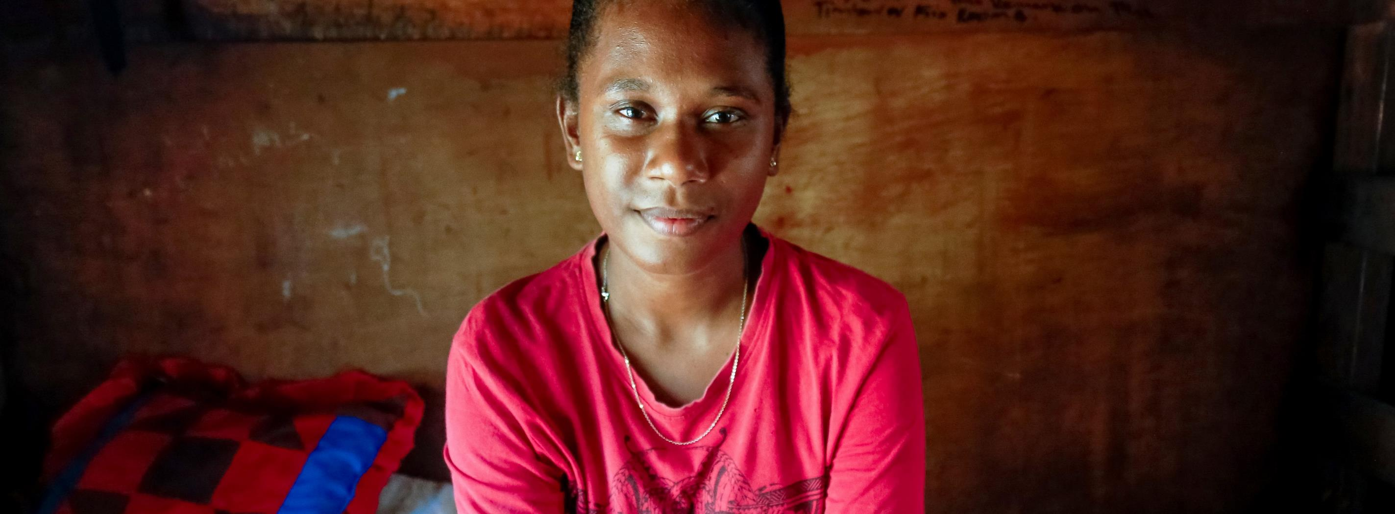
Help us listen to the cry of the poor. Show us how our choices affect others, including Shaniella and her community. Inspire us to act with compassion so that everyone can thrive. Lord, hear us. ​​ Lord, hear our prayer.​​
Photo: Neil Nuia
Notes:
Image caption: Shaniella sitting on her bunk in her dormitory at a Rural Training Centre near the capital Honiara, Solomon Islands, August 2021. Photo: Neil Nuia

Slide 6
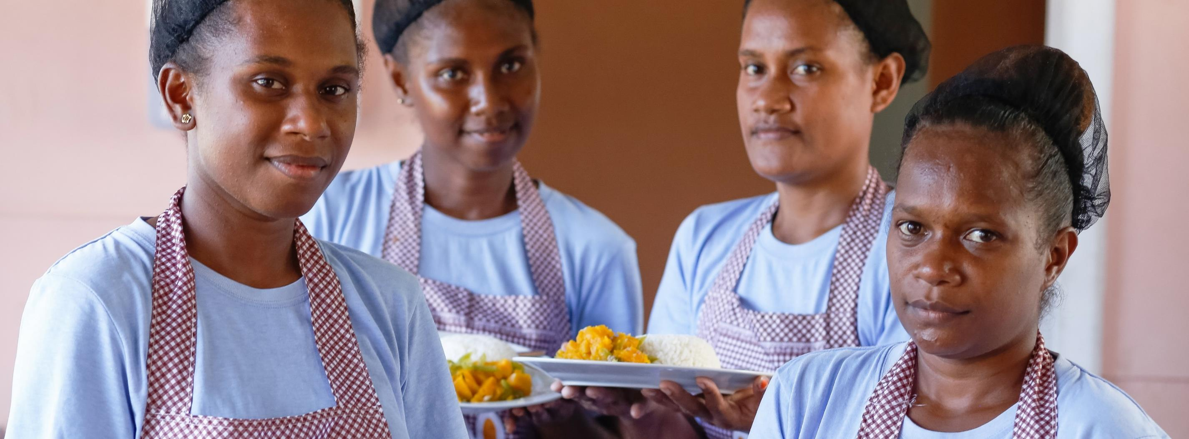
Help businesses everywhere to be sustainable, ethical and fair in all aspects of their work. Show us how we can encourage them to do that. Inspire us to make the world better for all. Lord, hear us. ​​ Lord, hear our prayer.​​
Photo: Neil Nuia
Notes:
Image caption: Shaniella (left) and her fellow students are taught how to prepare food at a rural training centre near the capital Honiara, Solomon Islands, August 2021. Photo: Neil Nuia

Slide 7
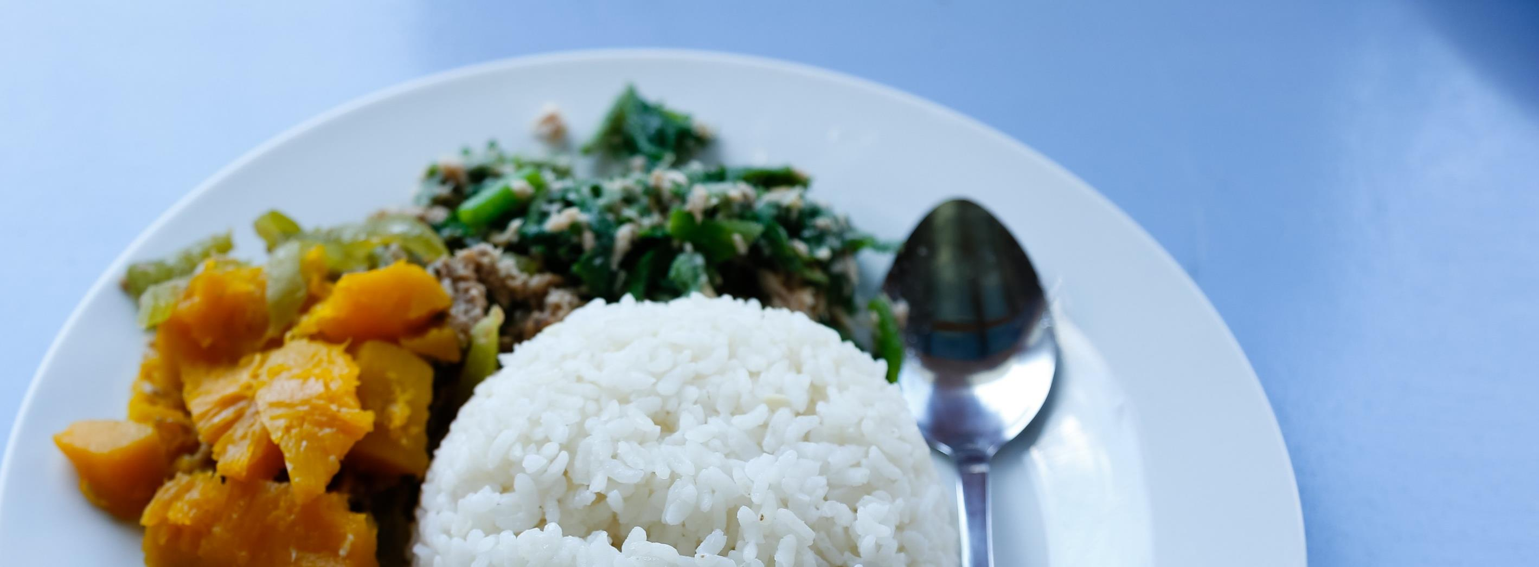
Help us not waste the Earth’s precious resources. Show us how to take greater care of the things we have access to. Inspire us to live simply. Lord, hear us. ​​ Lord, hear our prayer.​​
Photo: Neil Nuia
Notes:
Image caption: A meal prepared by students at a rural training centre near the capital Honiara, Solomon Islands, August 2021. Photo: Neil Nuia

Slide 8
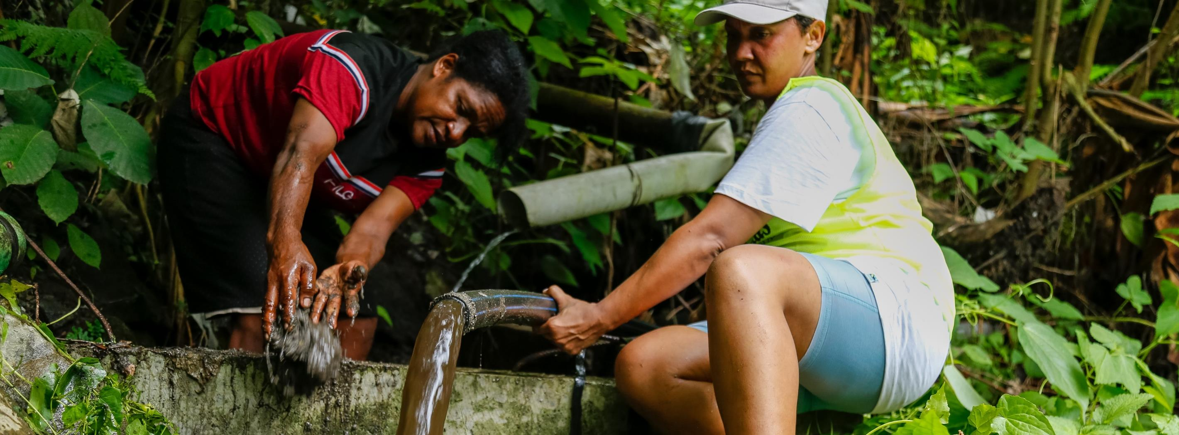
Help us learn how best to care for creation and for our brothers and sisters around the world. Show us new ways and remind us of ancient ways of better tending to the Earth and each other. Lord, hear us. ​​ Lord, hear our prayer.​​
Photo: Neil Nuia
Notes:
Image caption: Caritas Australia Solomon Islands (CASI) staff work to repair a gravity fed water system that was damaged during a landslide next to the rural training centre near the capital Honiara, Solomon Islands, August 2021. Photo: Neil Nuia

Slide 9
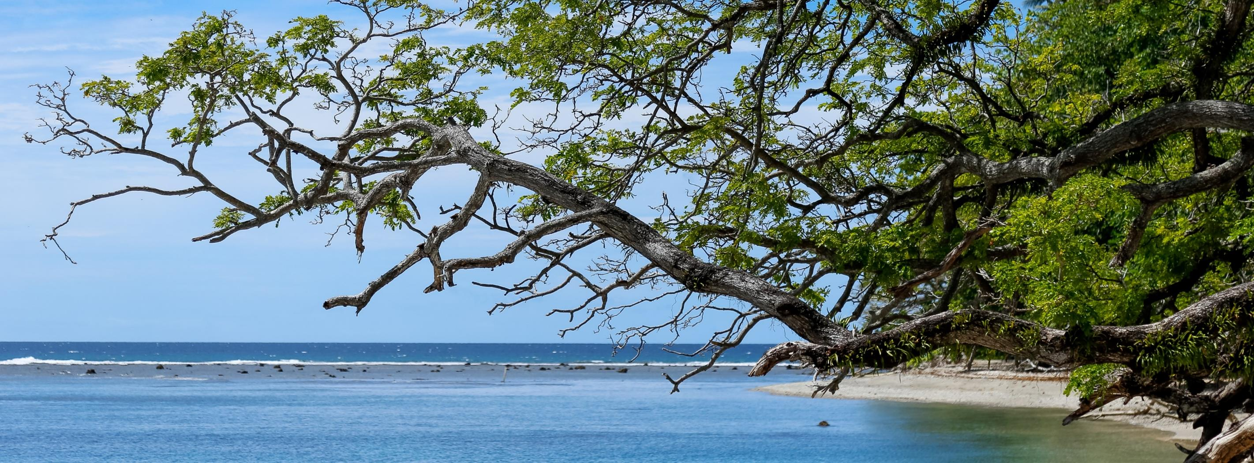
Help us remember to live in wonder and awe of creation. Show us how to love the Earth and each other as you do. Inspire us to practice gratitude every day. Lord, hear us. ​​ Lord, hear our prayer.​​
Photo: Neil Nuia
Notes:
Image caption: A view of the beach and ocean near a rural training centre near the capital Honiara, Solomon Islands, August 2021. Photo: Neil Nuia

Slide 10
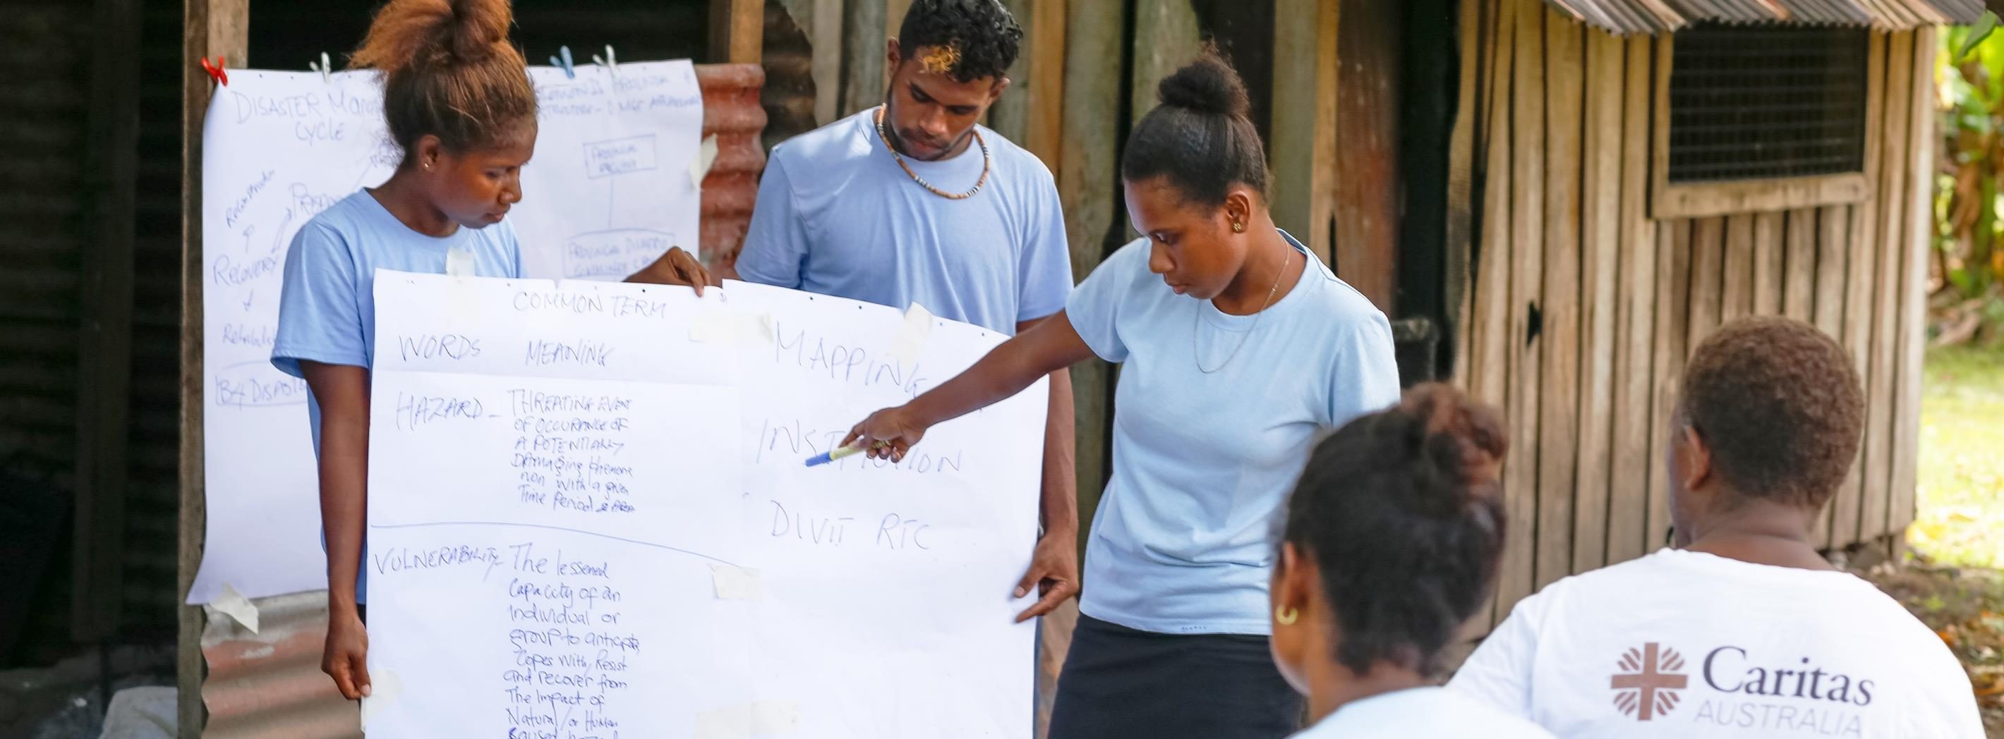
Help work together to make the world a healthy and fair place for all. Show us and our community how we can act for justice at local, regional, national and international levels. Inspire us to be brave and generous. Lord, hear us. ​​Lord, hear our prayer.​​
Photo: Neil Nuia
Notes:
Image caption: Shaniella (right) takes part in Disaster Risk Reduction training (DRR) at a rural training centre near the capital Honiara, Solomon Islands, August 2021. Caritas Australia assists with Disaster Risk Reduction (DRR) training workshops at the centre, raising students’ awareness about risks and hazards in their environment, evacuation procedures and how to respond during an emergency. Photo: Neil Nuia

Slide 11
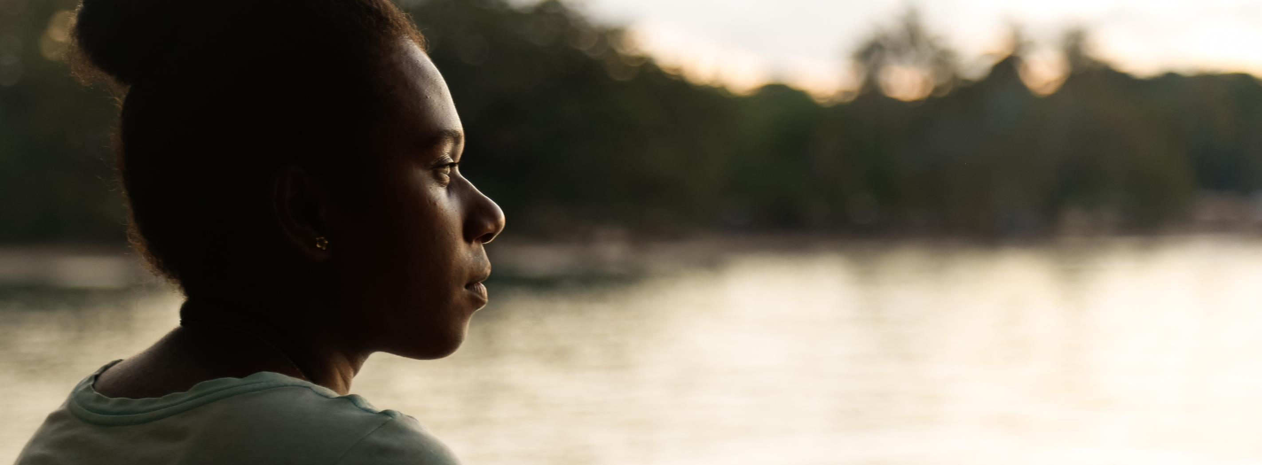
We pray, God of Living Water, lead us into your life of love and justice for all. ​​ Amen. ​​
Photo: Neil Nuia
Notes:
Image caption: Shaniella looks out over the ocean from her rural training centre near the capital Honiara, Solomon Islands, August 2021. Photo: Neil Nuia

Slide 12

END POVERTY
PROMOTE JUSTICE
UPHOLD DIGNITY

Slide 13



Thank You
www.caritas.org.au

